Slide 1
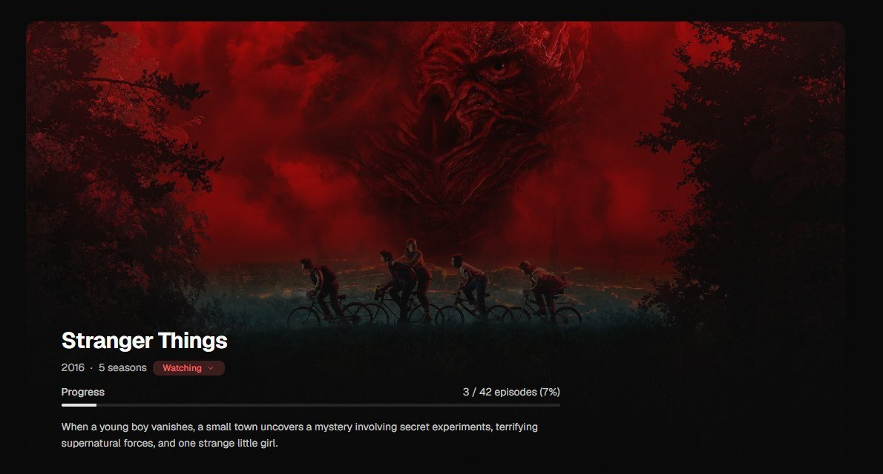
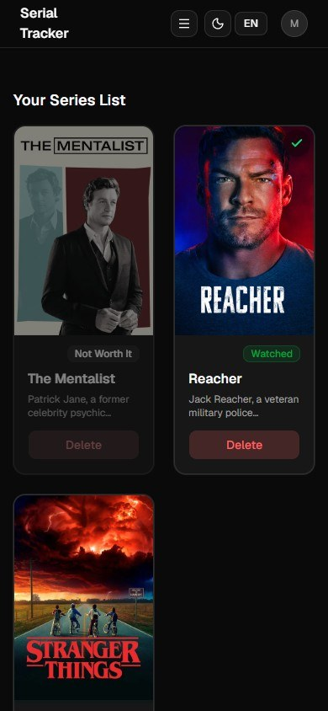
Series Tracker
REACT TECH STUDIO · SOFTSERVE ACADEMY
Never forget where you stopped.
Final demo · October 12, 2026

Slide 2




Our team
September 7 – October 12, 2026
DEVELOPERS
EXPERT
ES
YD
SP
Oleksii
Strotskyi
Elvira
Smal
Anna
Malchevska
Sofiia
Malysheva
Yaroslav
Dyrektorenko
Sofiia
Perkova
Serhii
Staryk

Slide 3






















People forget what to watch next and where they stopped.
React
TypeScript
Git
JavaScript
Node.js
GitHub
Express
GitHub Actions
Prisma
THE TASK
Vite
Neon
React Router
PostgreSQL
axios
One place to find, save and track your series.
JWT
TanStack Query
Zod
Tailwind CSS
TMDB API
shadcn/ui
Jest
i18next

Slide 4



He loves TV series.
MEET MAX
Forgets what to watch next
Forgets where he stopped

Slide 5




What we want to improve
WHAT'S NEXT
Animations
Email verification
Series filters
Black list

Slide 6

Thank you!
Series Tracker team
React Tech Studio · SoftServe Academy · October 12, 2026

